Slide 1
COMP1521
Week 4 Tutorial
Functions

Slide 2
Conventions
$a registers for arguments
$v0 for return values (and syscall codes)
$t registers for temporary values
When you call another function, they may overwrite it
You must assume they have been changed
$s registers for saved values
When you call another function, they will leave it the way they found it
Conversely, if you (as a function) use one, you must restore it
$ra for return address

Slide 3
How to save registers – the stack
begin
end
push
pop
Prologue: save everything you need to use that also needs to keep its value afterwards
$s registers you use
$ra if calling another function
Epilogue: restore all registers you saved back to their original value

Slide 4
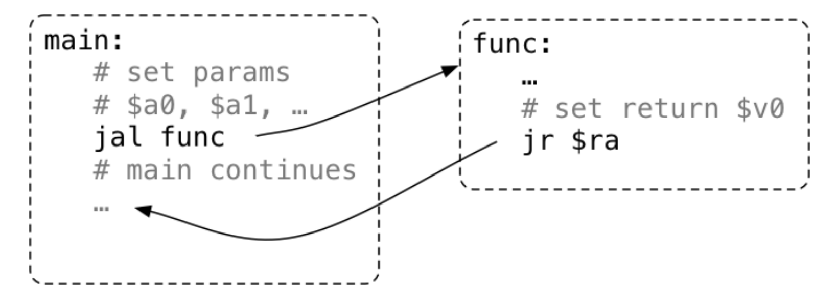
Calling a function
Set up arguments in $a registers
Use jal instruction
Return value will be in $v0

Slide 5
Concluding remark
Functions are important for the assignment
You must follow the calling conventions! (or the marking tests may not run properly)

